Slide 1


Advanced Computer Vision
Naeemullah Khan
naeemullah.khan@kaust.edu.sa
KAUST Academy
King Abdullah University of Science and Technology
Computer Vision

Slide 2
Practical Deep Learning
Practical Implementation of Deep Learning algorithms is just as much an art as it is a science.
The main takeaways if not to start from scratch rather to build on top of the previous knowledge.
Today, we will look at some important tools used in the practical implementation of Deep Learning algorithms.
Computer Vision

Slide 3
Outline
Data Handling
Data Augmentation
Transfer Learning
Ensembling
Dropout
Batch Normalization
Computer Vision

Slide 4
DataLoaders
As we have previously established that Deep Learning has been made possible by large amount of data and computational resourse
An important aspect to keep in mind is the data handling:
How do we handle large amounts of data?
How to we read different components of data (from possible different parts of our hard drive) and provide it to our training algorithms?
How do we feed this data to SGD algorthims in a streamlined manner?
PyTorch provides Dataset and DataLoaders to handle data in an efficient manner.
We will extend the Dataset and DataLoaders class to construct our own Dataloaders
Computer Vision

Slide 5
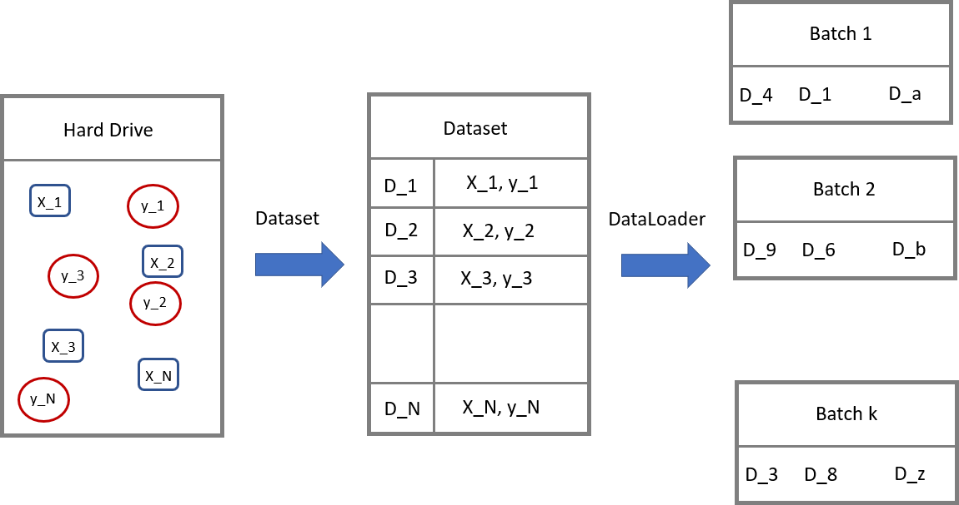
DataLoaders (cont.)
Computer Vision

Slide 6
Data Augmentation
Data is the fundamental building block of any machine learning algorithm
In several applications we don’t have access to unlimited data
So, we use Data Augmentation techniques to improve the performance of our models
Note: It is better to spend time on data rather than fine-scale architecture search in deep learning
Computer Vision

Slide 7
Data Augmentation (cont.)
Create virtual training samples
Horizontal flip
Random crop
Color casting
Geometric distortion
Translation
Rotation
Computer Vision

Slide 8
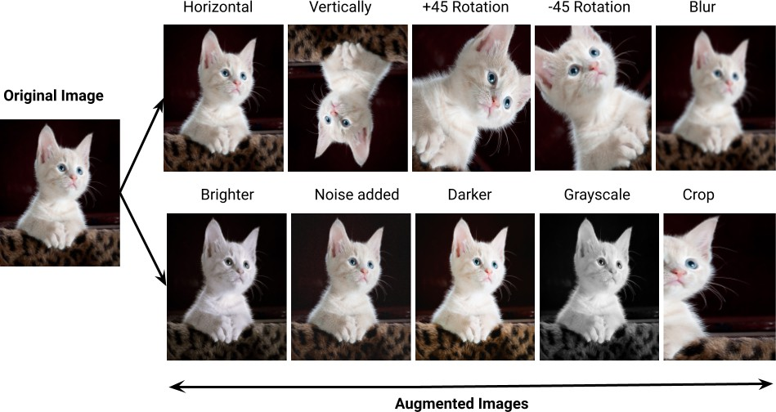
Data Augmentation (cont.)
⁰https://pranjal-ostwal.medium.com/data-augmentation-for-computer-vision-
b88b818b6010
Computer Vision

Slide 9
Ensembling
Team-work is the best policy
Multiple networks for the same task
Max Voting for final classification
Computer Vision

Slide 10

Ensembling - A simple Analysis
Let’s assume that we have a test dataset with N elements and an ensemble of M models.
Also assume that the probability of error of the label for an image on a model in the ensemble is denoted by p(e) and is i.i.d
For an example assume M = 3 and e = 0.1
Then probability of error of label for the max voting ensemble will be
$$p\left(e\right)= e^{3}+\left({3 \atop 2}\right) e^{2} (1−e)$$
For the above example p(e) = 0.028, which is significantly lower than a single model
Computer Vision

Slide 11
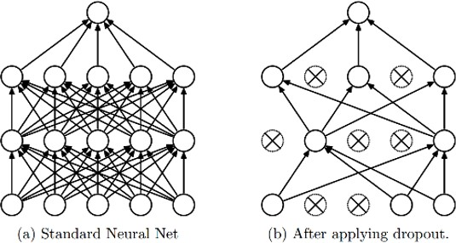
Dropout
⁰Srivastava JMLR 2014
KAUST Academy
Computer Vision

Slide 12
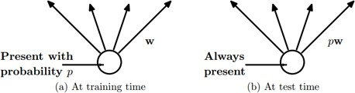
Dropout
Intuition: successful conspiracies
50 people planning a conspiracy
Strategy A: plan a big conspiracy involving 50 people
Likely to fail. 50 people need to play their parts correctly.
Strategy B: plan 10 conspiracies each involving 5 people
Likely to succeed!
Main Idea: approximately combining exponentially many different neural network architectures efficiently
⁰Srivastava JMLR 2014
KAUST Academy
Computer Vision

Slide 13
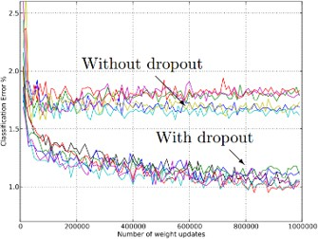
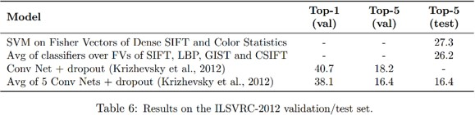
Dropout
⁰Srivastava JMLR 2014
KAUST Academy
Computer Vision

Slide 14
Batch Normalization
Consider a single layer y = Wx
The following could lead to tough optimazation
Inputs x are not centered around zero (need large bias)
Inputs x have different scaling per element (entries in W will need to vary a lot)
⁰Slide based on CS231n by Fei-Fei Li, Yunzhu Li & Ruohan Gao
Computer Vision

Slide 15
Batch Normalization
Consider a single layer y = Wx
The following could lead to tough optimazation
Inputs x are not centered around zero (need large bias)
Inputs x have different scaling per element (entries in W will need to vary a lot)
Idea: Force inputs to be ”nicely scaled” at each layer!
⁰Slide based on CS231n by Fei-Fei Li, Yunzhu Li & Ruohan Gao
Computer Vision

Slide 16
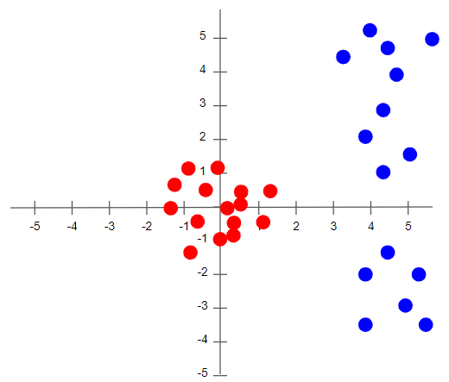
Normalization
https://towardsdatascience.com/batch-norm-explained-visually-how-it-works-and-why-neural-networks-need-it-b18919692739
Computer Vision

Slide 17
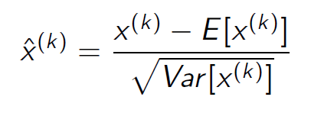
Batch Normalization
Consider a batch of activations at some layer. To make each dimension zero-mean unit-variance, apply:
⁰Slide based on CS231n by Fei-Fei Li, Yunzhu Li & Ruohan Gao
Computer Vision

Slide 18
Batch Normalization
Consider a batch of activations at some layer. To make each dimension zero-mean unit-variance, apply:
Problem: What if zero-mean, unit variance is too hard of a constraint?
⁰Slide based on CS231n by Fei-Fei Li, Yunzhu Li & Ruohan Gao
Computer Vision

Slide 19
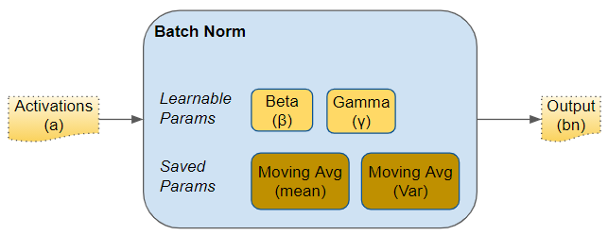
Batch Normalization
https://towardsdatascience.com/batch-norm-explained-visually-how-it-works-and-why-neural-networks-need-it-b18919692739
Computer Vision

Slide 20
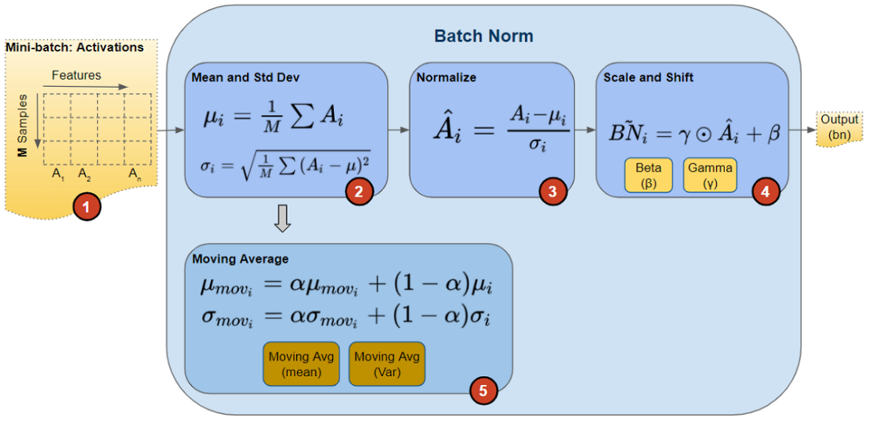
Batch Normalization
https://towardsdatascience.com/batch-norm-explained-visually-how-it-works-and-why-neural-networks-need-it-b18919692739
Computer Vision

Slide 21
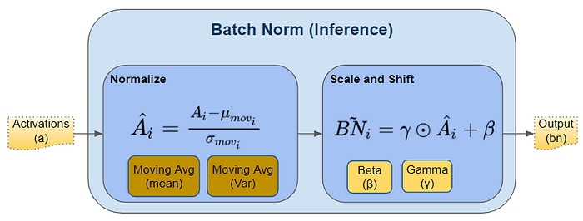
Batch Normalization
https://towardsdatascience.com/batch-norm-explained-visually-how-it-works-and-why-neural-networks-need-it-b18919692739
Computer Vision

Slide 22
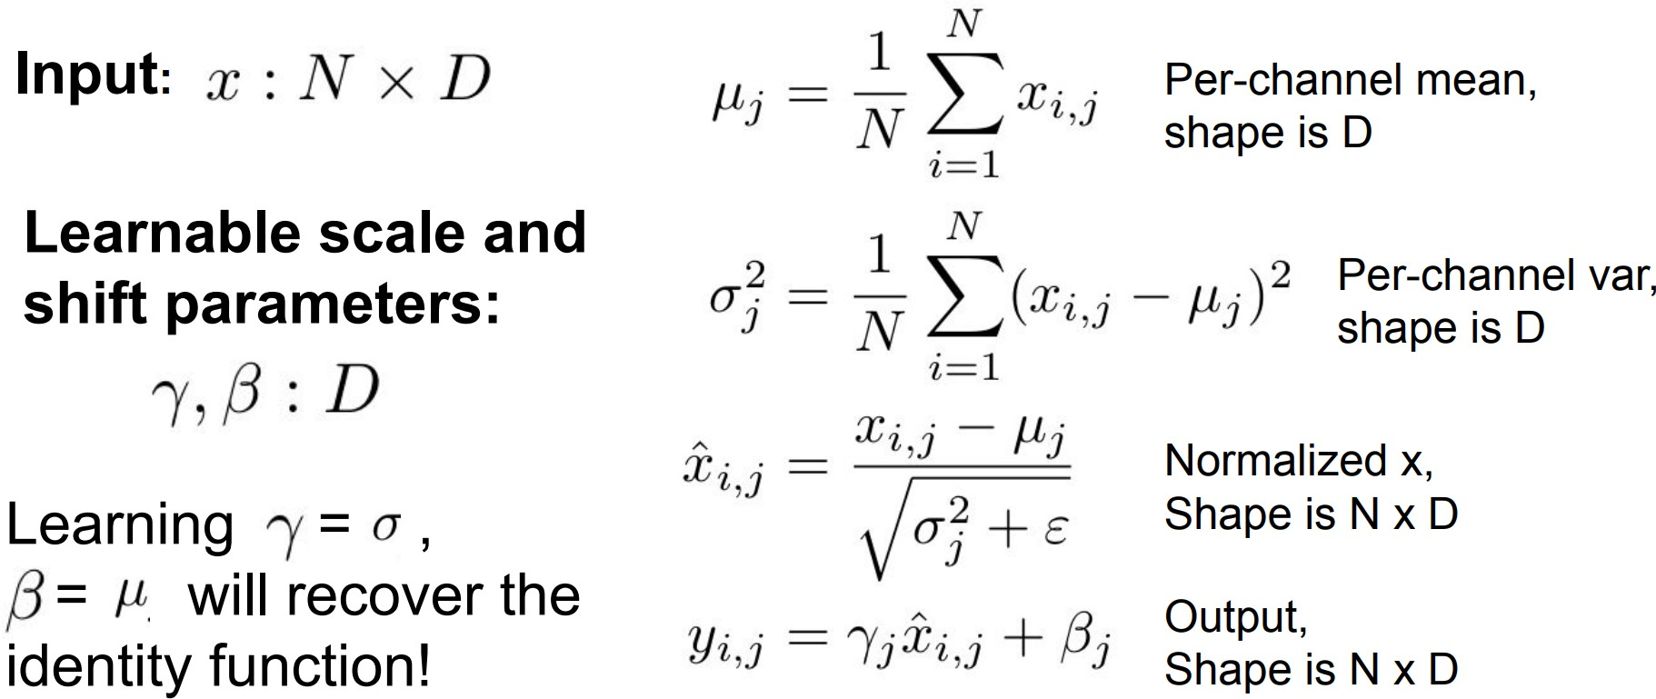
Batch Normalization
⁰Slide based on CS231n by Fei-Fei Li, Yunzhu Li & Ruohan Gao
Computer Vision

Slide 23
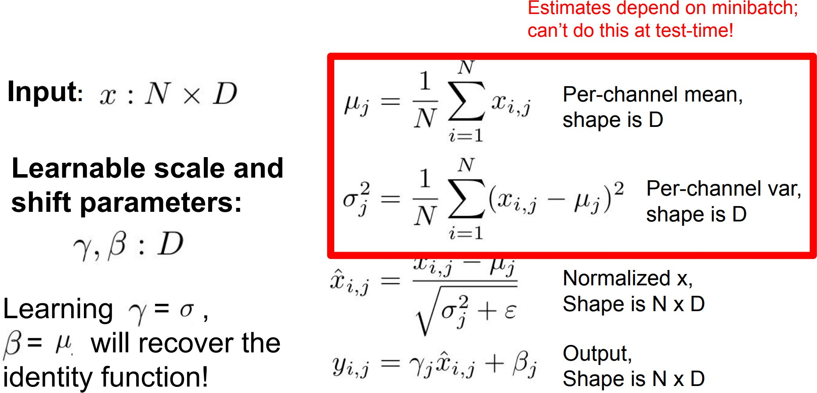
Batch Normalization
Computer Vision

Slide 24
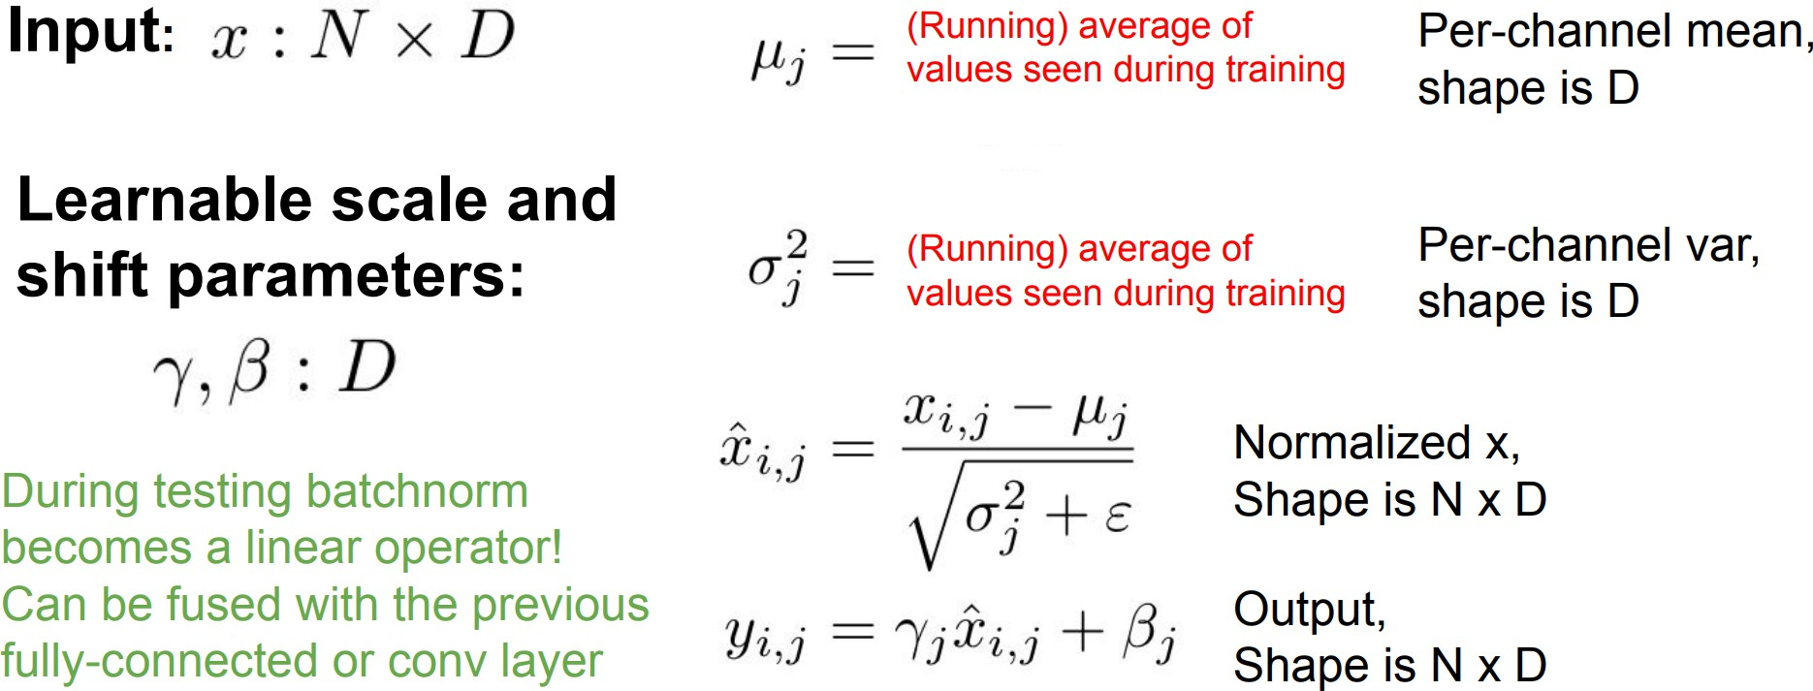
Batch Normalization
⁰Slide based on CS231n by Fei-Fei Li, Yunzhu Li & Ruohan Gao
Computer Vision

Slide 25
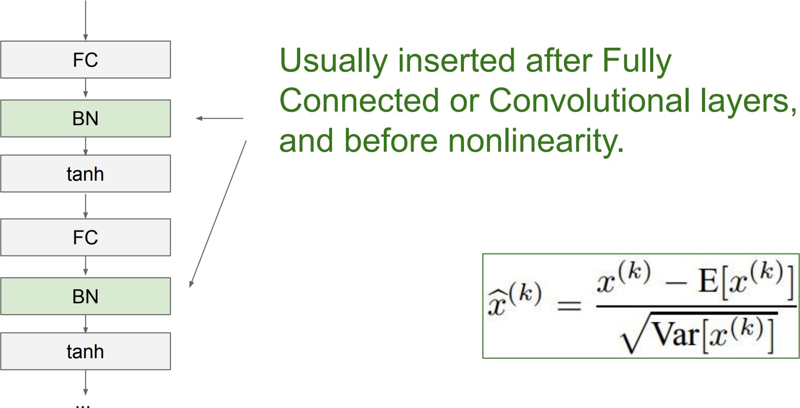
Batch Normalization
Computer Vision

Slide 26
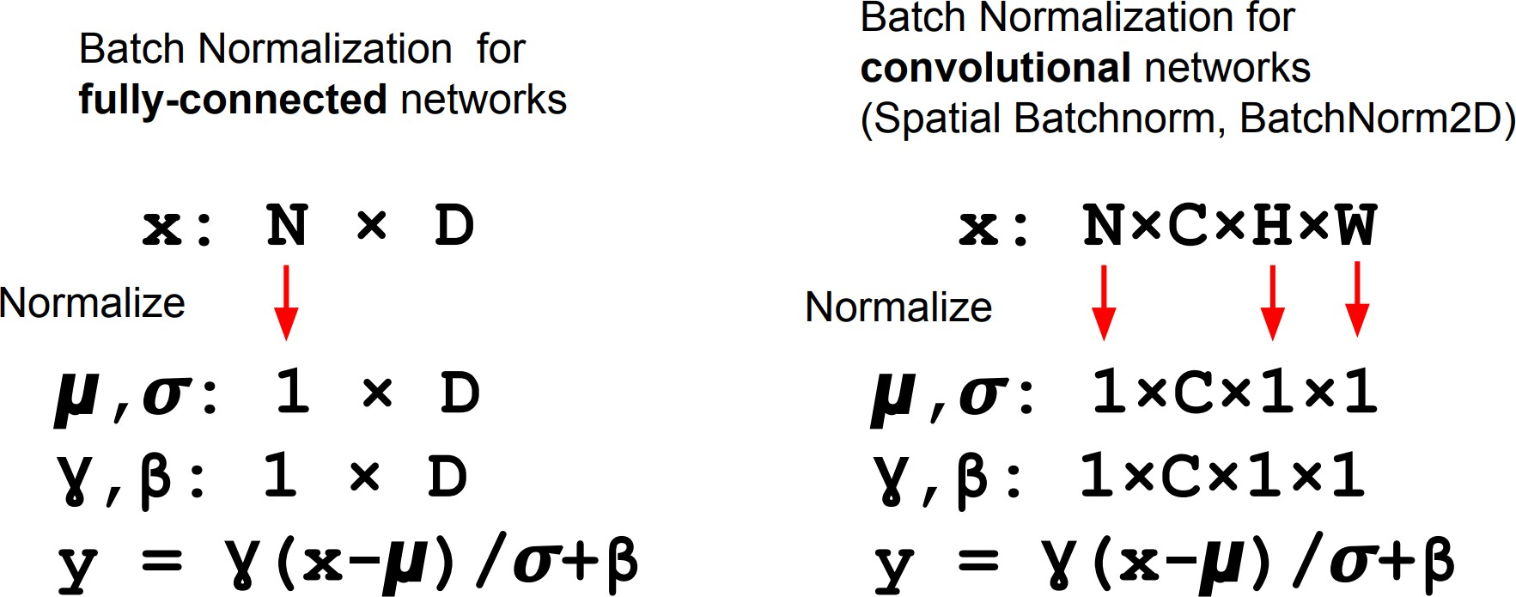
Batch Normalization
⁰Slide based on CS231n by Fei-Fei Li, Yunzhu Li & Ruohan Gao
Computer Vision

Slide 27
Batch Normalization
Advantages:
Makes deep networks much easier to train!
Improves gradient flow
Allows higher learning rates, faster convergence
Networks become more robust to initialization
Acts as regularization during training
Zero overhead at test-time: can be fused with conv!
⁰Slide based on CS231n by Fei-Fei Li, Yunzhu Li & Ruohan Gao
Computer Vision

Slide 28
Batch Normalization
Advantages:
Makes deep networks much easier to train!
Improves gradient flow
Allows higher learning rates, faster convergence
Networks become more robust to initialization
Acts as regularization during training
Zero overhead at test-time: can be fused with conv!
Disadvantages:
Behaves differently during training and testing: this is a very common source of bugs!
⁰Slide based on CS231n by Fei-Fei Li, Yunzhu Li & Ruohan Gao
Computer Vision

Slide 29
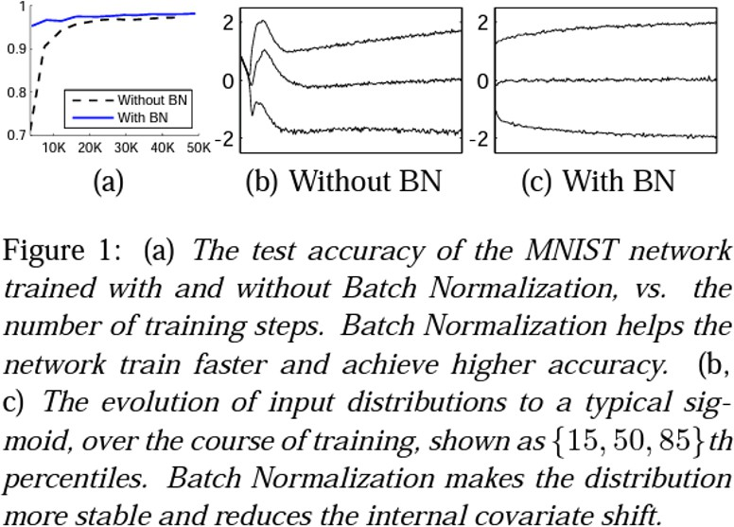
Batch Normalization
⁰Ioffe and Szegedy 2015
Computer Vision

Slide 30
Things to Remember
Training Deep Networks
Dropout
Data augmentation
Activation
Batch normalization
Transfer learning
Use Fine-tuning when possible
Computer Vision

Slide 31
Full Deep Learning Pipeline
Data Pre-processing
Architecture
Loss
Optimizer
DataLoaders
Data Augmentation
Fine-Tuning
Ensembling
Computer Vision

